Slide 1


Dynamics and reverse engineering of gene expression during B cell differentiation in Germinal Centers, using single cell snapshot data
Student: Martin Banchero
Supervisor: Perry Moerland, PhD
Co-supervisor: Aldo Jongejan, PhD
February 12, 2021

Slide 2
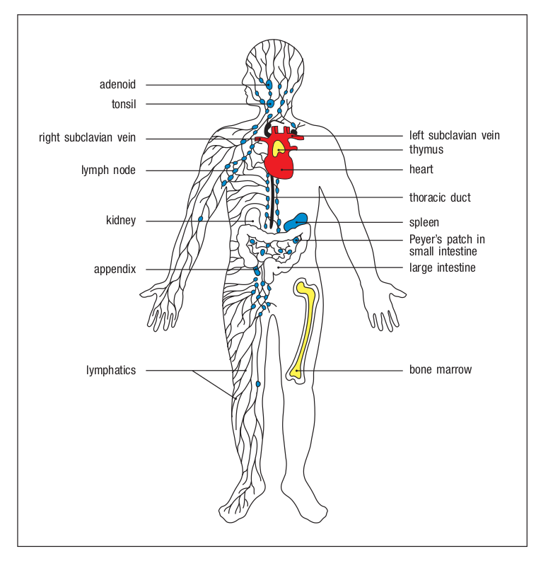
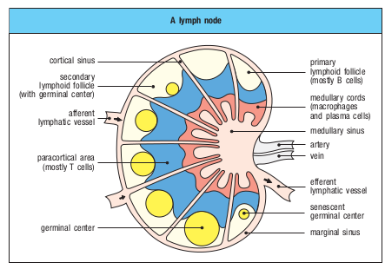
Introduction
Location in human body of adaptive immune response
Place for adaptive immune response in peripheral lymphoid organs:
Spleen
Lymph nodes
Including gut-associated tonsils.
Secondary lymphoid follicles:
Contain germinal centers, areas for intense B cell proliferation during immune response.
Janeway’s Immunobiology 9th edition

Slide 3
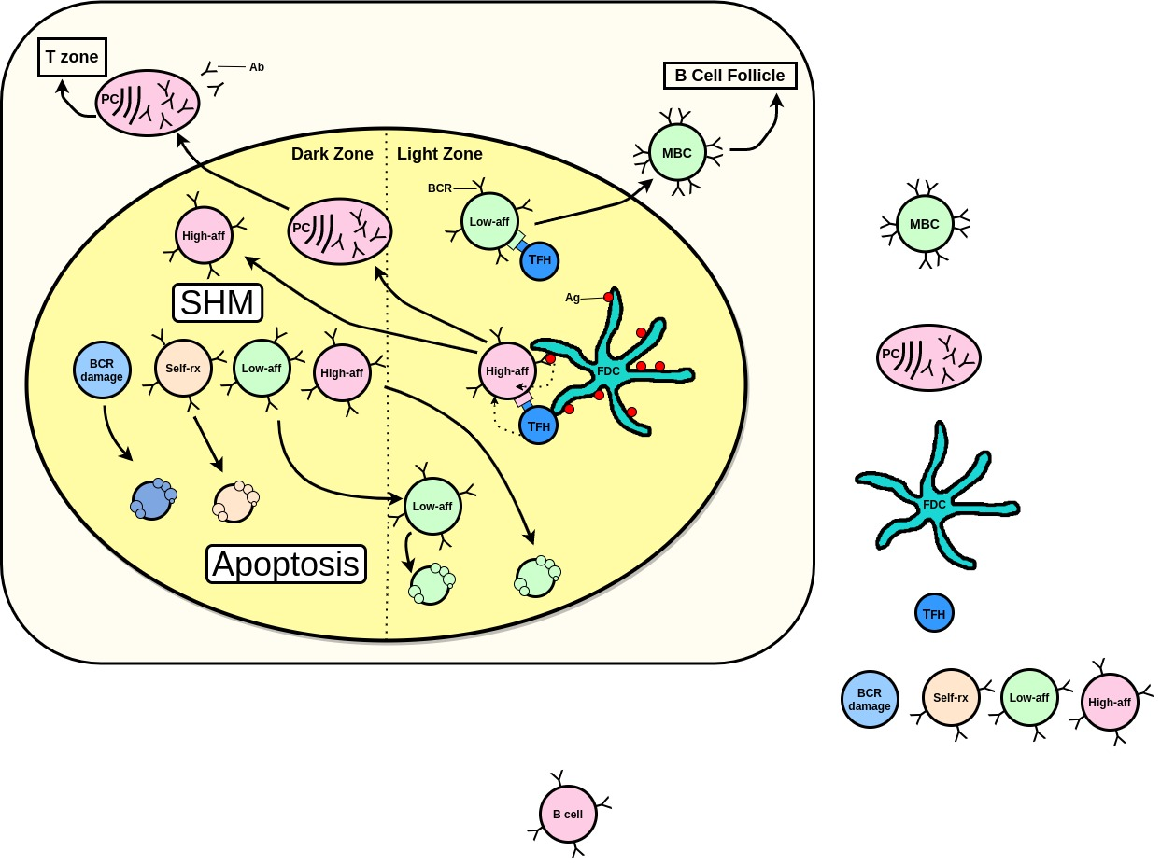
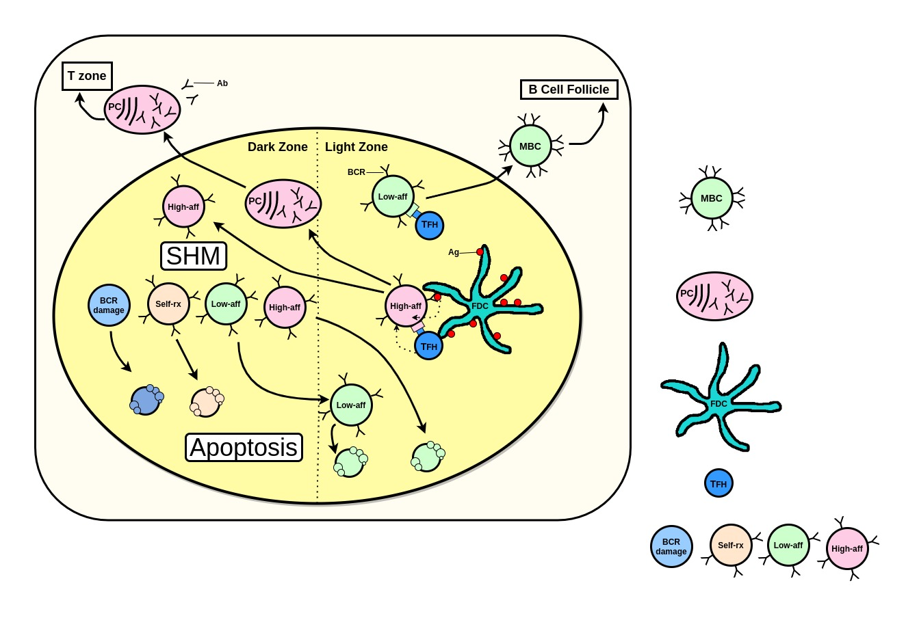
Introduction
Germinal centre: Schematic representation
GC containing two compartments:
Dark zone
B cells (Centroblasts) experience class switch recombination (CSR) and Somatic hypermutation (SHM) of BCRs genes.
Light zone
The B cells (now Centrocytes) compete for survival and differentiation signals.
Memory B cells
Plasma cells
Follicular dendritic cells
T follicular helper cell
Review Lau et al. 2020
B cells

Slide 4
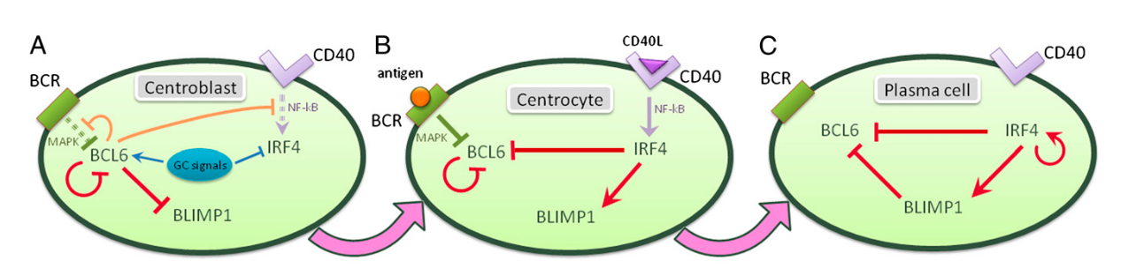
Introduction
Exit from Germinal Centres
The exit from GC highly regulated by small transcriptional module.
Martinez et al. 2012
BCL6: Transcriptional repressor, highly expressed in GC B cells and essential for their formation.
IRF4: Induction of (IRF4), an essential regulator of plasma-cell development.
BLIMP1: Drives the regulatory program associated with plasmacytic differentiation.

Slide 5
Research project goal
Research question:
Recover temporal behaviour from single-cell RNA sequencing snapshot data.
Reverse engineering dynamics of gene expression using Martinez et al. 2012 model.
Data:
Normal B cell subsets from human lymphoid organs (spleen or tonsil) of 91 pre selected genes (Milpied et al. 2018)
Approach:
To tackle the research question I use InferenceSnapshot framework proposed in Ocone et al. 2015

Slide 6
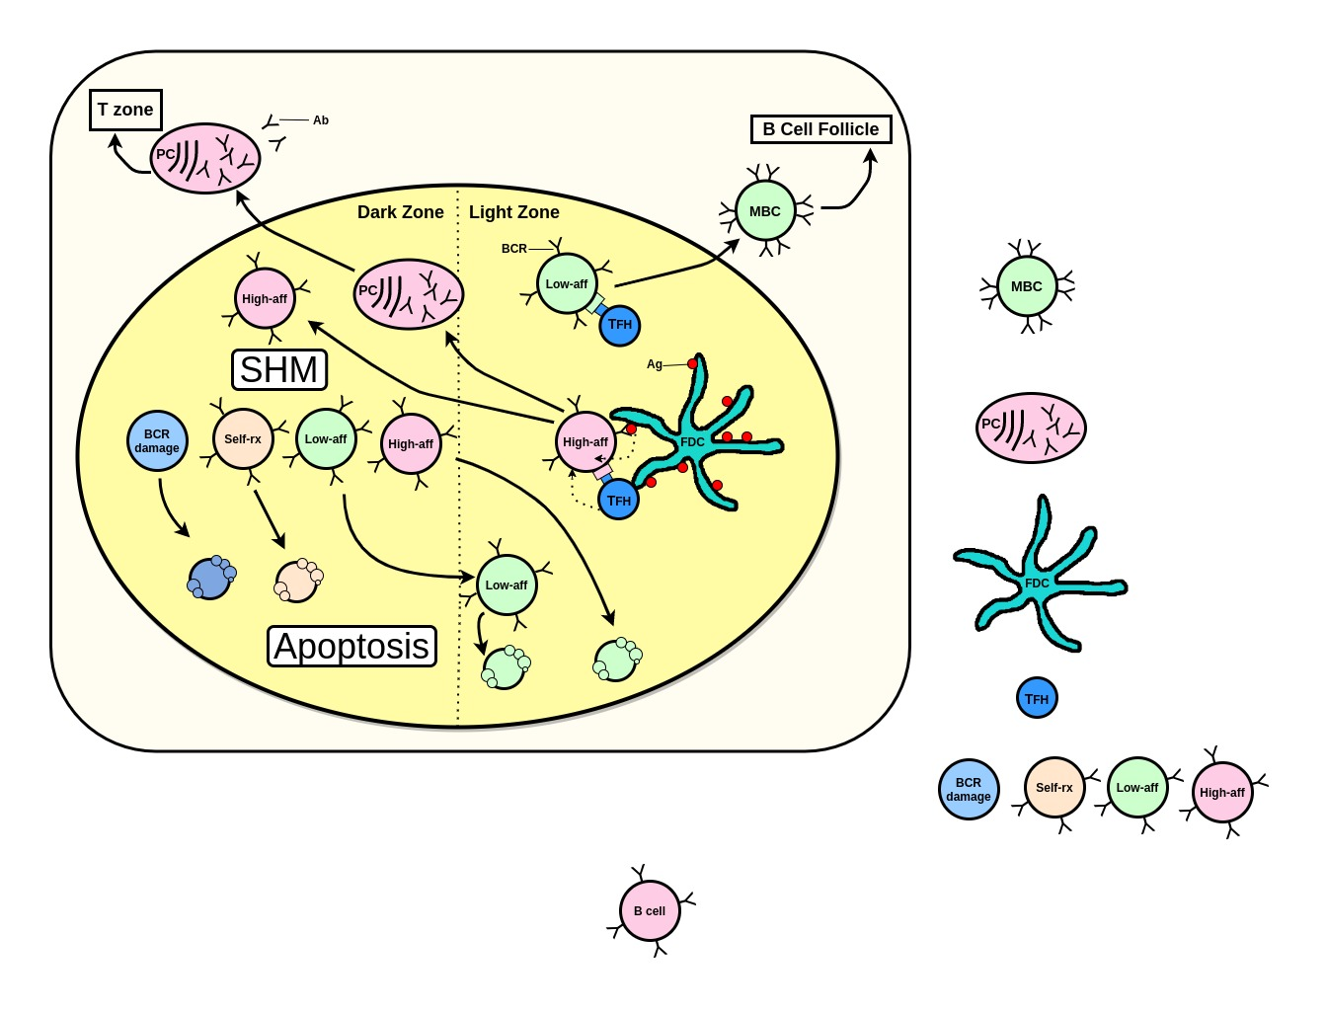
Data
Human lymphoid organs data
Statistics for SC-qPCR data:
Total number of cells passing QC: 767
Number of genes: 91
Samples of Follicular lymphoma(FL) B cells were removed.
Sample | #sorted single-cell | # cells passing QC
SP1 | 212 | 188
SP2 | 234 | 186
SP3 | 223 | 201
TS1 | 234 | 192
Subsets of 767 by phenotype index using surface markers
767
Mem (IgM⁺ IgD⁺): 45 cells
Mem (IgM⁻ IgD⁺): 42 cells
Mem (IgM⁺ IgD⁻): 42 cells
Mem (IgM⁻ IgD⁻): 40 cells
Early plasmablast: 33 cells
Late plasmablast: 39 cells
Mature plasma cells: 23 cells
DZ: 256 cells
LZ: 230 cells
other: 17 cells
Milpied et al. 2015
95
169
503

Slide 7

Data
ODE Solution data
Obtained from the numerical solution of the ODEs proposed by Martinez et al. 2012
In house generated (E. Merino Tejero 2020, personal communication).
Contains 400 time-points with time-steps of 0.5.
Gene expression values of BCL6, BLIMP1 and IRF4 that form the small regulatory network.

Slide 8
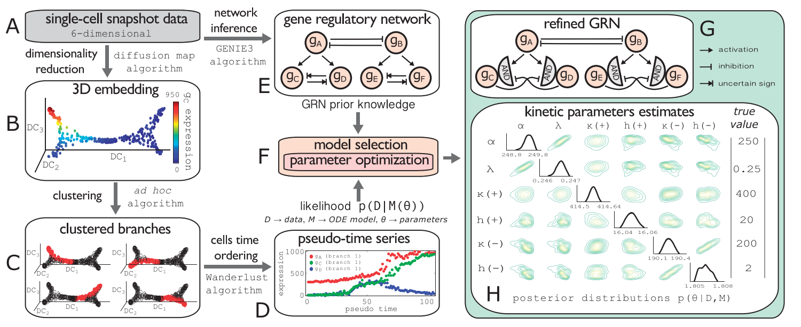

Methods
InferenceSnapshot framework
Work with Aldo Jongejan
python implementation
Ocone et al. 2015

Slide 9
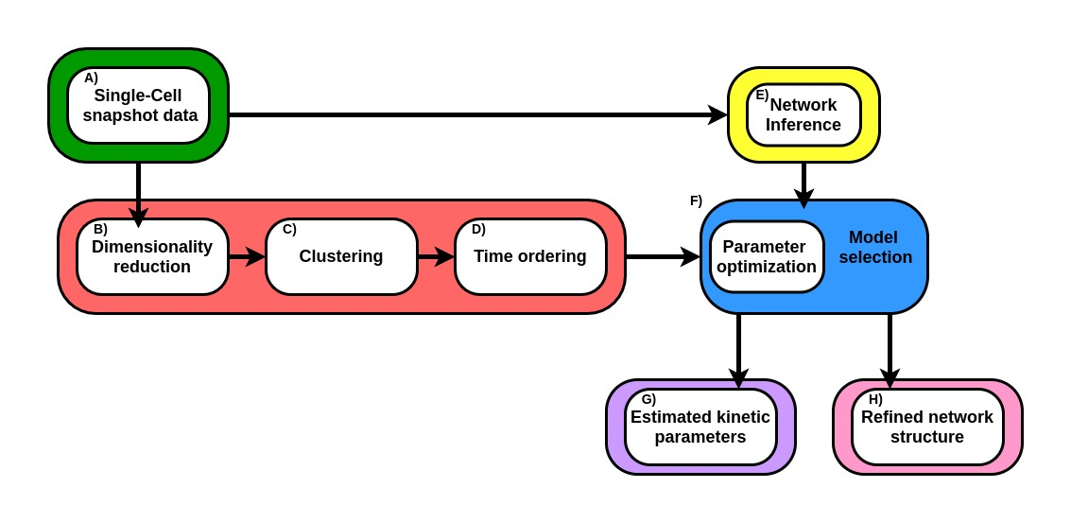
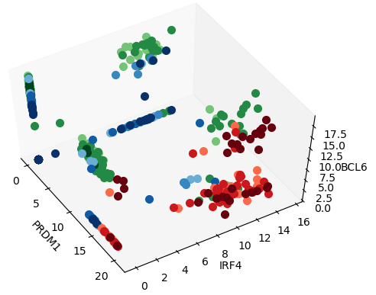
Results
Diffusion maps: Human lymphoid organs data
Plot of gene expression values of BCL6, IRF4 and BLIMP1.
Scheme InferenceSnapshot framework
BLIMP1
Prior information of root cells needed for:
More precise clustering of differentiation pathways, therefore more precise pseudo-time series.

Slide 10
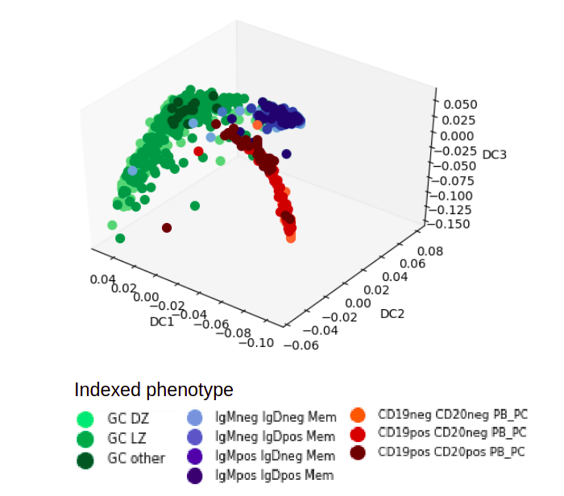
Results
Diffusion maps
Plot with the first 3 diffusion components(DC)
SC-qPCR snapshot data
767 cells(rows)
91 genes(col)
91 dims
Diffusion map with 6 dimensions. I used the first 3 DC.
One parameter: Gaussian kernel width σ
Here σ = 19.95
Notes:
Diffusion map embedding
Useful to determine CS and CF.
Necessary to get more precise clustering of the differentiation pathway.
More reliable pseudo-t series through Wanderlust algorithm.

Slide 11
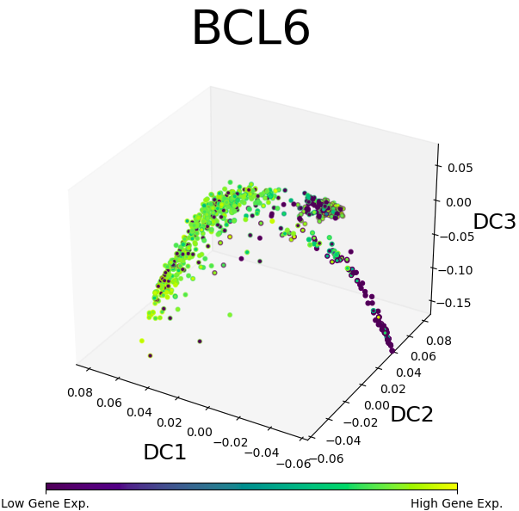
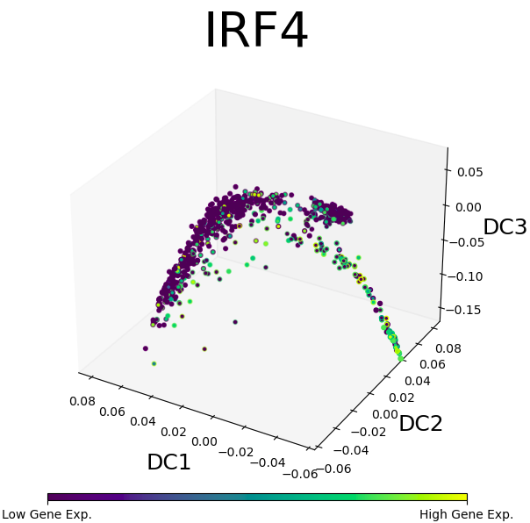
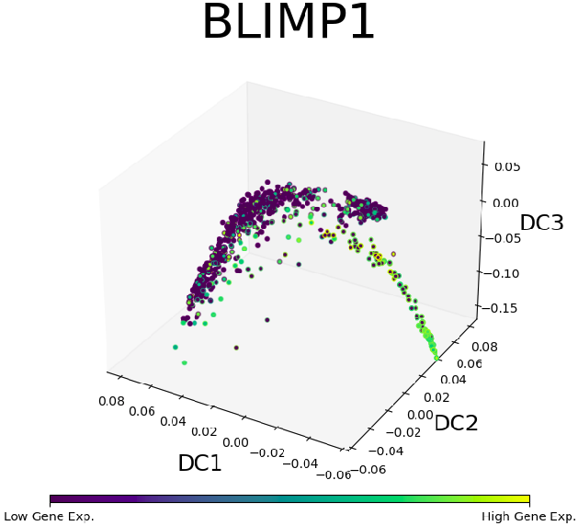
Results
Milpied data: Diffusion maps
SC-qPCR snapshot data
767 cells(rows)
91 genes(col)
91 dims
Diffusion map
(reduced to 6 dim)
Sigma 19.95
Colored by gene
Diffusion map color by gene expression levels of BCL6, IRF4 and BLIMP1 showing correspondence with literature.

Slide 12
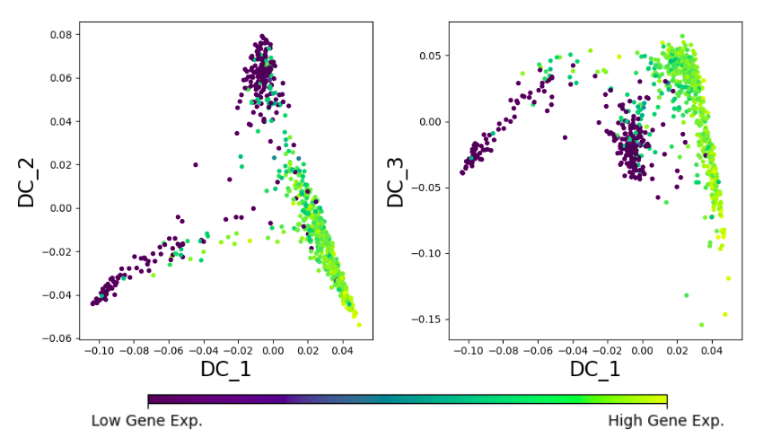
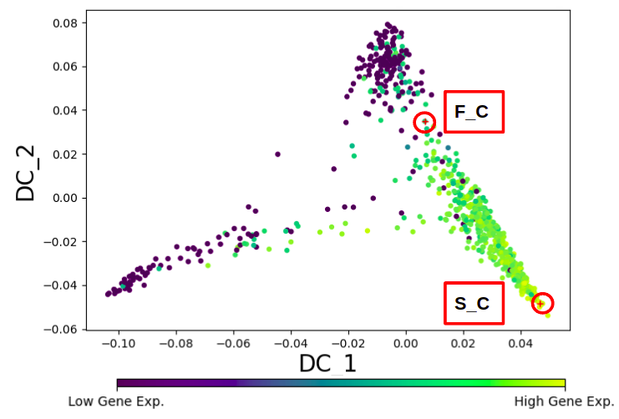
Results
Branch clustering
Here I look to the expression of BCL6
Step 1: Select starting and final cells from DC1 vs DC2 2D plot.

Slide 13
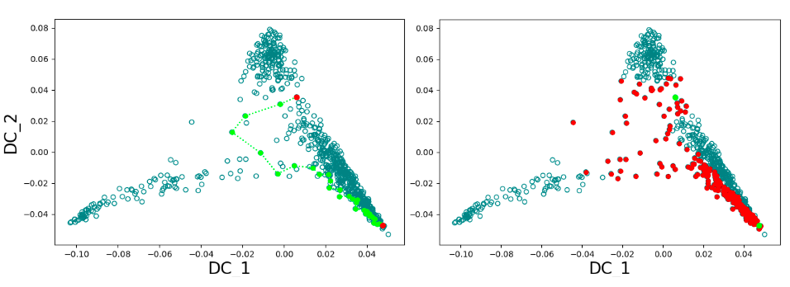
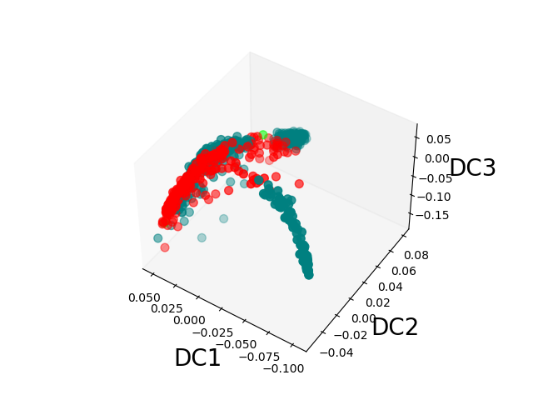
Results
Branch clustering
Select s_c and f_c
ANN followed by
shortest path
Branch composed by nodes in shortest path + Nn
F_C
S_C
3D plot visualization of clustered branch

Slide 14
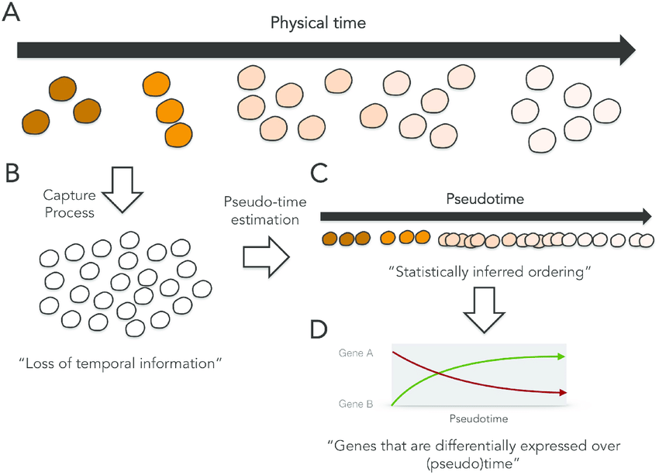
Results
Time Ordering
K. Campbell et al. 2016
Notes:
Following a stimulus, cells will change from one cell-type to another.
Is not possible to track expression levels of an individual cell over time. The cell is lysed when the RNA is extracted.
Sample at multiple time-points and obtain snapshots of the gene expression profiles.
Since some of the cells will proceed faster along the differentiation than others, each snapshot may contain cells at varying points along the developmental progression.
Using statistical methods to order the cells along one or more trajectories which represent the underlying developmental trajectories, this ordering is referred to as “pseudotime”.

Slide 15
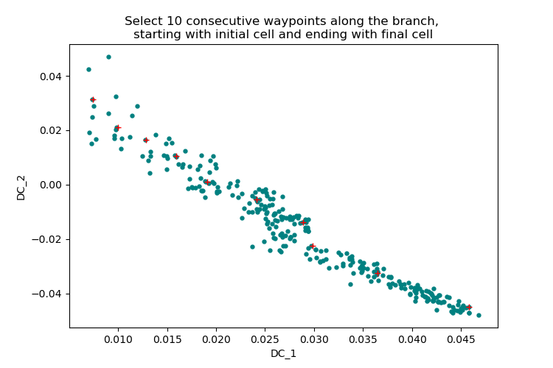
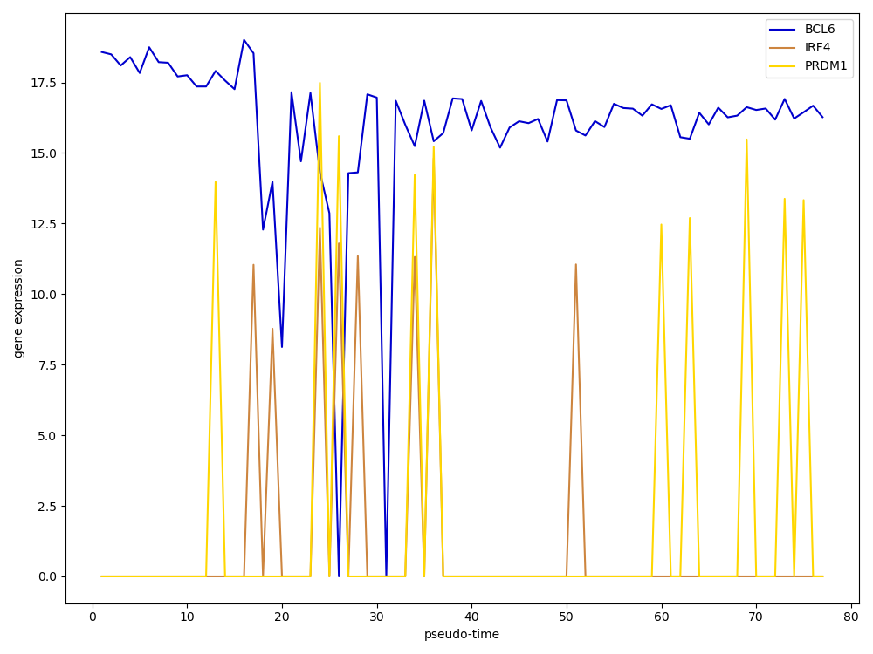
Results
Time ordering: Wanderlust algorithm
Wanderlust:
graph-based trajectory detection algorithm
Wanderlust output
Mainly noise!
Notes:
Wl algorithm:
To map single cells from multidimensional data onto a one-dimensional developmental trajectory.
Starting cell has to be defined a priori(overcomed with diffusion maps)
Assume non-branching developmental trajectory(overcomed by branch clustering)

Slide 16
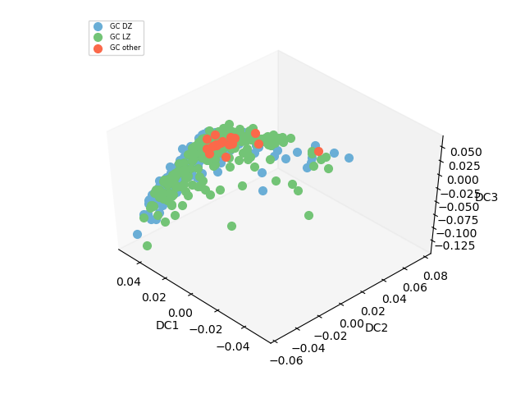
Results
Wanderlust algorithm
Only GC cells
noise!

Slide 17
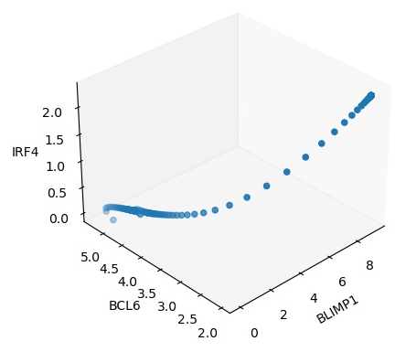
Results
Martinez ODE numerical solution data
To check the implementation of InferenceSnapshot framework.
3d plot for the 3 genes, BCL6, IRF4 and BLIMP1

Slide 18
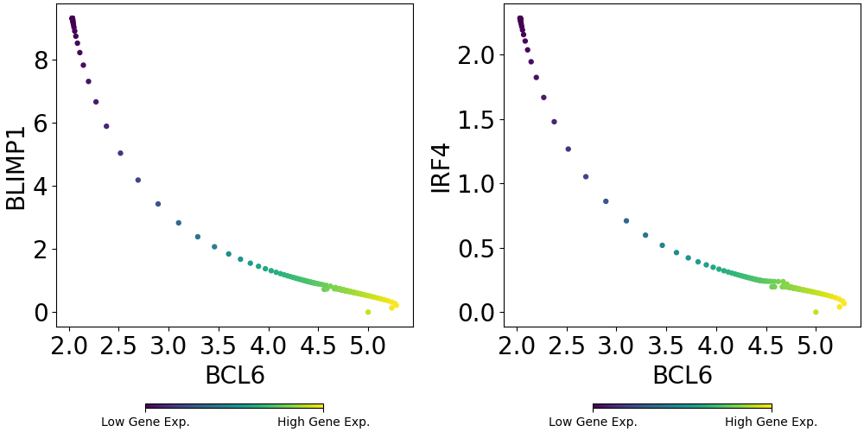
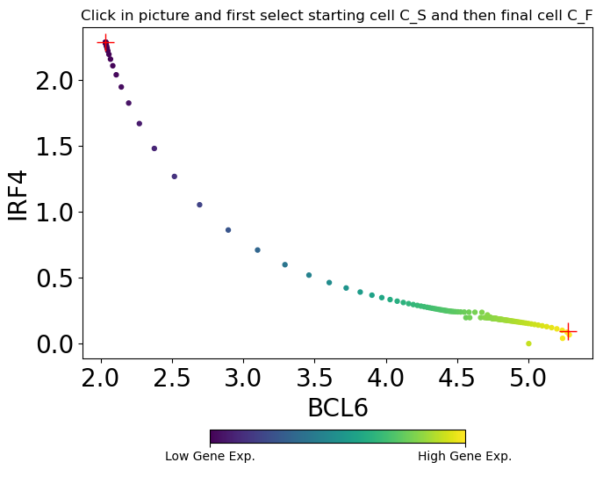
Results
Martinez ODEs numerical solution data
Here I look to the expression of BCL6
3d plot for the 3 genes, BCL6, IRF4 and BLIMP1

Slide 19
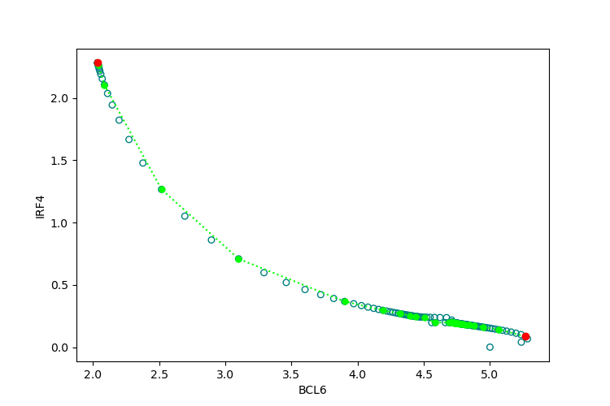
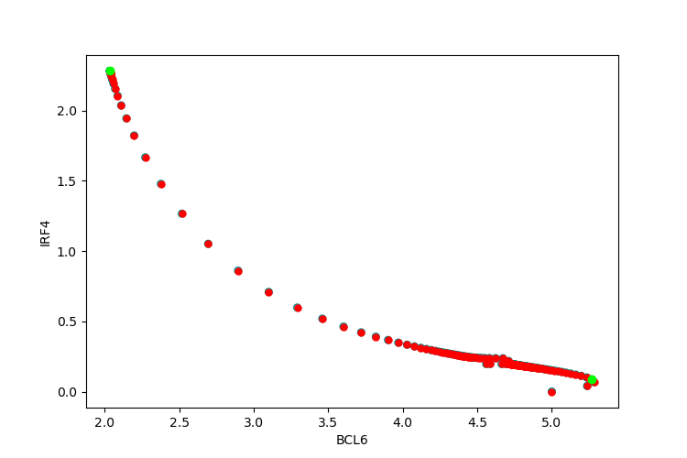
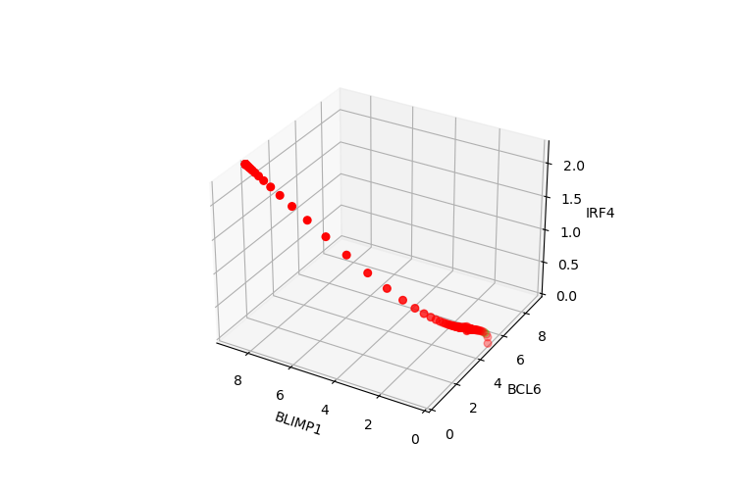
Results
Martinez ODEs numerical solution data: Branch Clustering
Select SC and FC
Shortest path
Clustered branch
Cluster branch showed in 3d

Slide 20
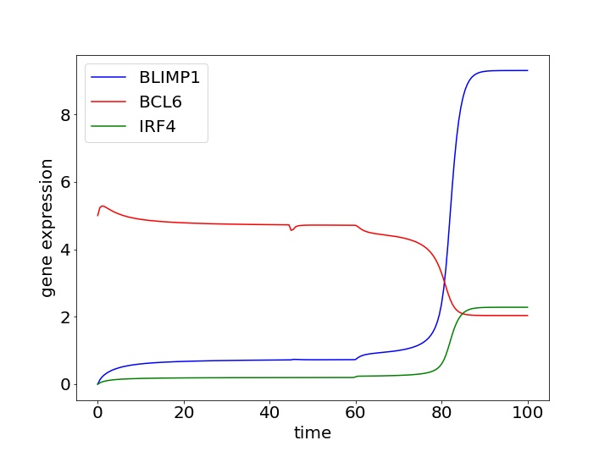
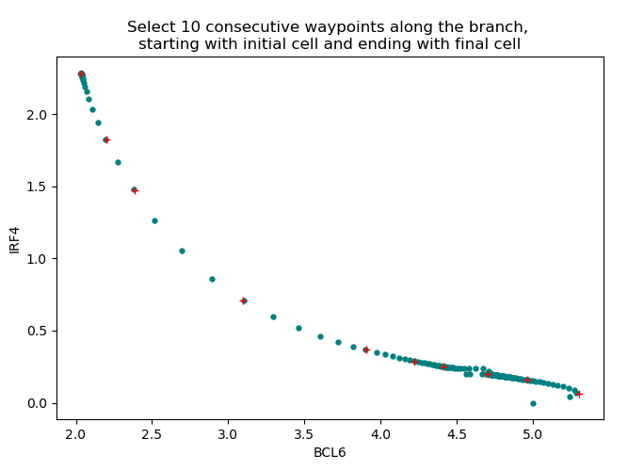
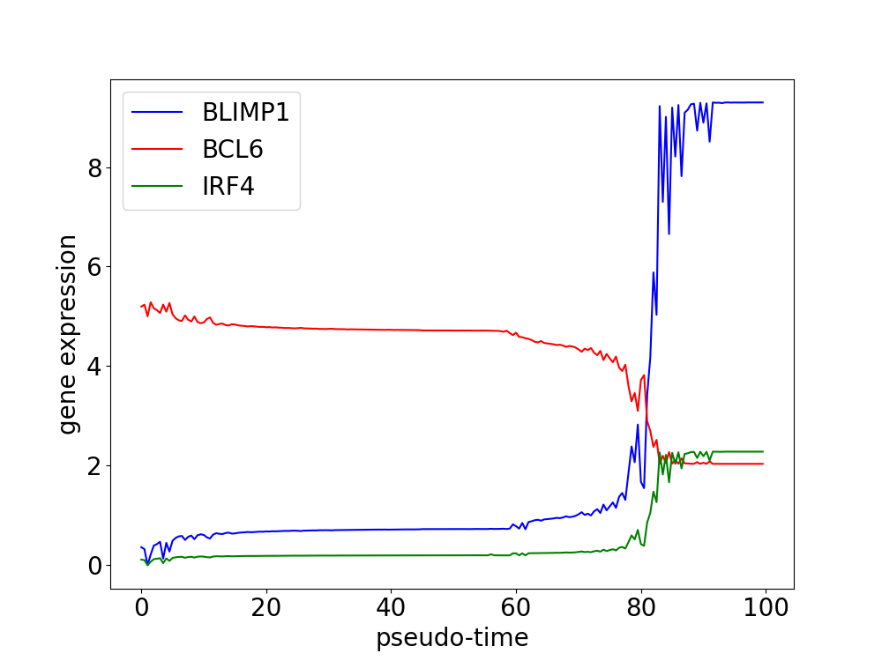
Results
Martinez ODE numerical solution data: Wanderlust
Plot of raw data
Wanderlust output
End
Start
InferenceSnapshot implementation showing good results!

Slide 21
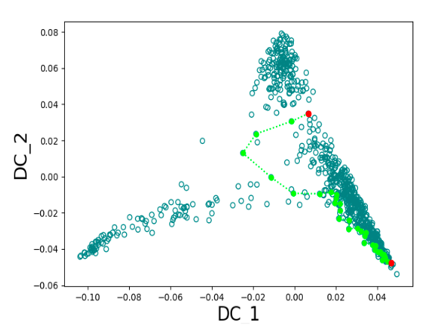
Results
Branch clustering
Back to the shortest path problem using Human lymphoid organs data
Why this detour in shortest path?
Next I look in detail into the clustering algorithm

Slide 22
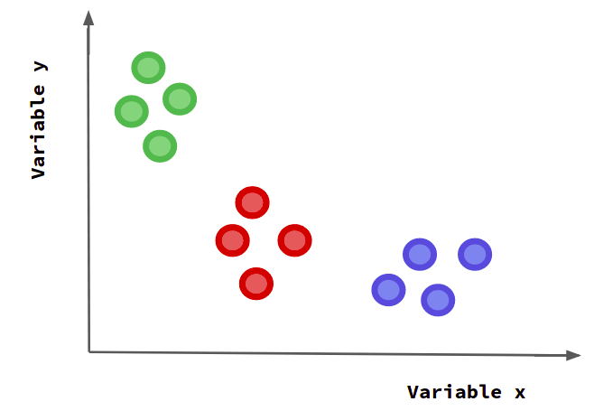
Results
Branch clustering: Toy data set
Toy data set
Approach:
Use different K’s for ANN.
Test Dijkstra shortest path parameters (weight, direction)
12 data point divided into 3 clusters.

Slide 23
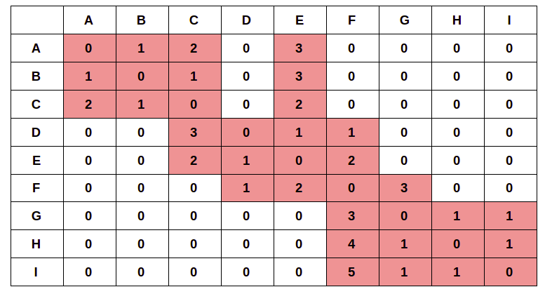
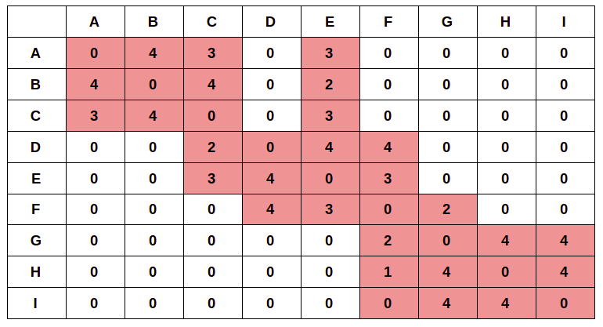

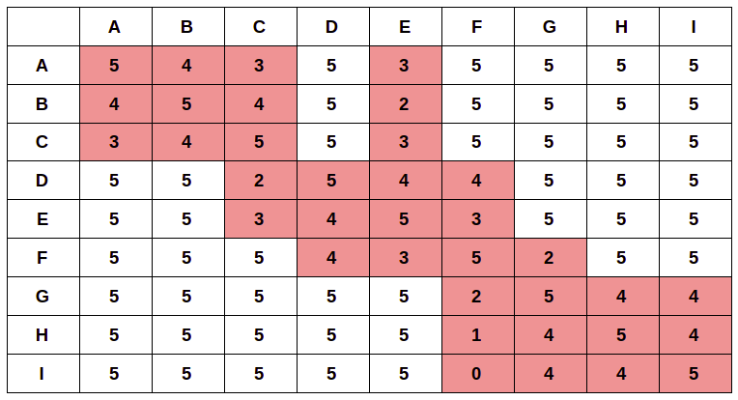
Results
Branch clustering
1: Select starting cell (SC) and final cell (FC) from a set of N cells.
6: Branch defined by shortest path nodes + Nn
2: Calculate distance of each data point to all data points and store in queue the k-nn.
FC
e.g k=4
[A, B, C, E]
Shortest path weight = 15
I
3: Store the graph into Adjacency matrix (D)
7
For the sake of clarity I use 9 cells
Variable y
H
8
4
G
6
2
F
4
0
D
5
3
A
3
2
SC
3
E
3
C
B
1
4:
Adj <- max(D) - D # the distance is inverted
Adj = max(D) <- 0 # assign weight 0 (no edge)
Variable x
5: Dijkstra Shortest path (Adj, weighted, directed)
Notes:
Matrix is square but not simetric, ie node H(includes F but F does not include H)

Slide 24
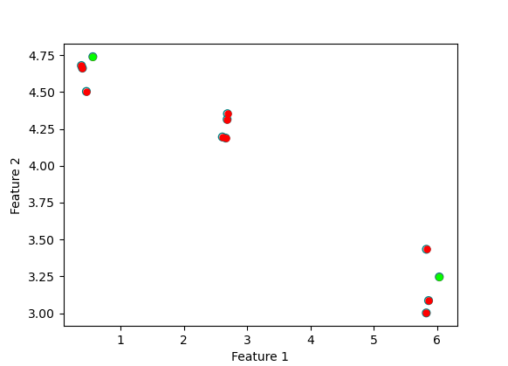
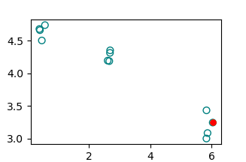
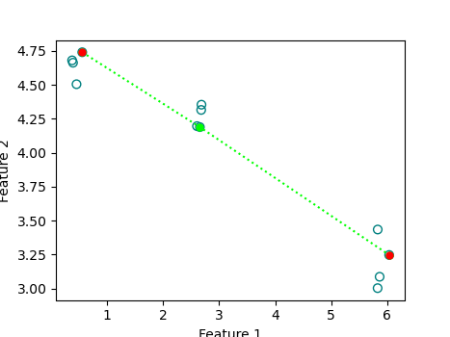
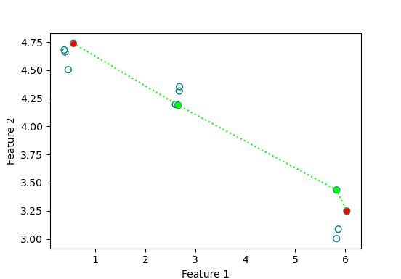

Results
Branch clustering: Toy data set
Different Ks in the range [4, 12]
With and without distance inversion
K = 4(3 nn)
K = 7(6 nn)
Final branch with Nn = 4
No distance inversion
With Distance inversion
Notes:
32

Slide 25
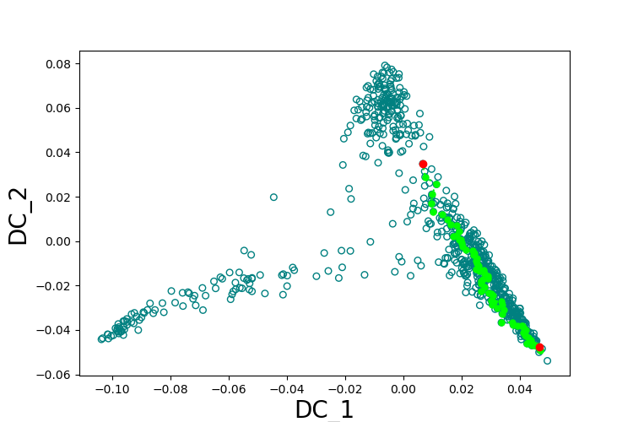
Results
Correction shortest path
With distance inversion
Without distance inversion
More accurate shortest path!
Notes:
32

Slide 26
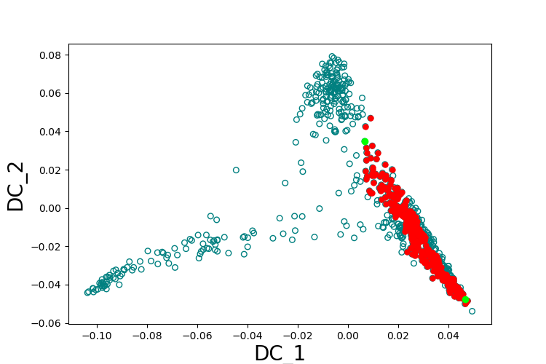
Results
Branch clustering
Better result without distance inversion
With distance inversion
Next step check if I can obtain a better pseudo time series!

Slide 27
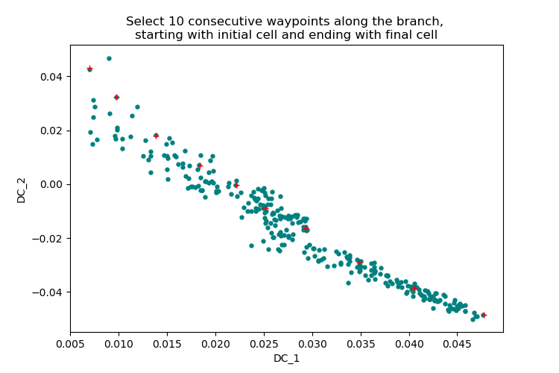
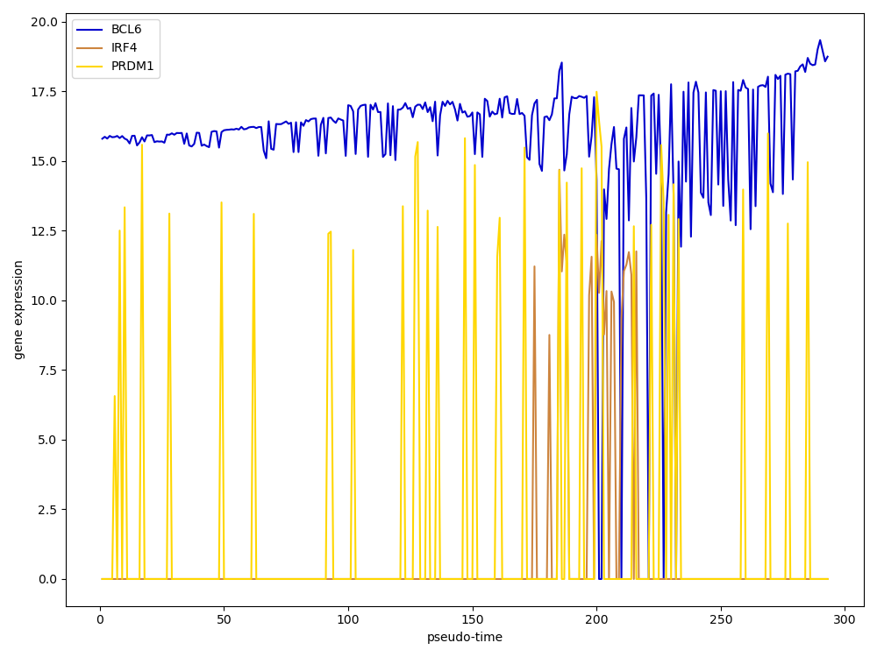

Results
Wanderlust algorithm
Wanderlust output
Mainly noise again!

Slide 28
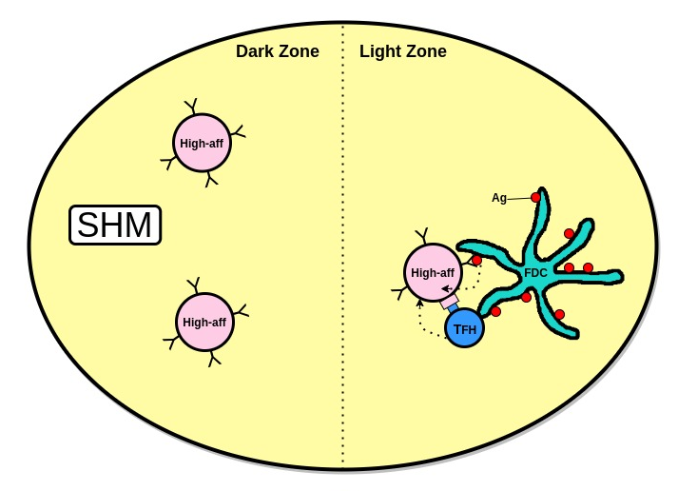
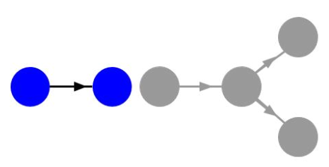
Results
Cell time ordering: Wanderlust algorithm
Circular B cell differentiation in GC
Wanderlust:
Assume one branch.
Linearity

Slide 29
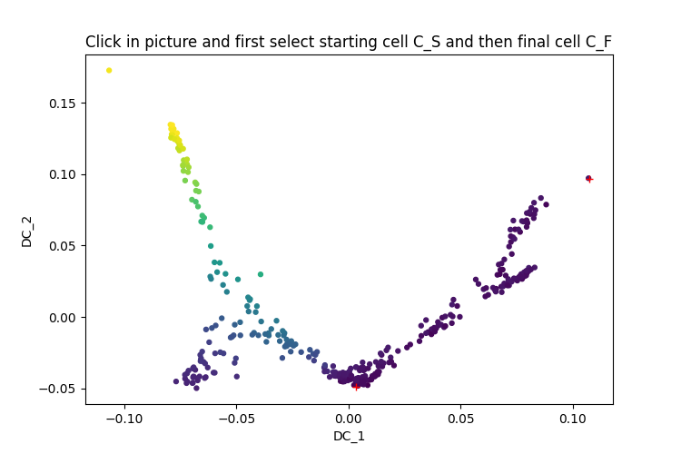
Discussion and Conclusion
Diffusion maps improve clustering facilitating the search of a root cell (starting cell) for trajectory inference.
Branch clustering shown a good performance avoiding distance inversion.
Still remains open why is use the inverted distances in InferenceSnapshot framework.
In Ocone paper show good results (For simulated data, toggle switch, no sparsity)
Toggle switch simulated data from Ocone et al.
Time ordering using Wanderlust algorithm not applicable for Milpied data. Not possible to recover temporal behaviour (Pseudo time series). The trajectory of GC B cells is circular.

Slide 30
Future Improvements
Two approaches
1) Replace Ocone modules:
Replacement of Wanderlust by a method that can infer pseudo time series from circular trajectories i.e PAGA (Partition-based graph abstraction).
This also might lead to a simplification of the framework (skip branch clustering step).
2) Different framework:
Use recently developed methods to infer GRN i.e GRISLI directly infer de novo the GRN from scRNA-seq data.
First estimates the velocity of each cell, i.e., how each gene’s expression is increasing or decreasing in the dynamical process for each cell.
Applicable for circular developmental trajectories

Slide 31



Acknowledgments
Supervisor:
Perry Moerland PhD
Co-supervisor: Aldo Jongejan, PhD
Elena Tejero, PhD student
Antoine Van Kampen, Professor

Slide 32
Fin

